Slide 1
Mobile price prediction classification regression
Ayo, Shola, Behrooz
19.1.2021

Slide 2
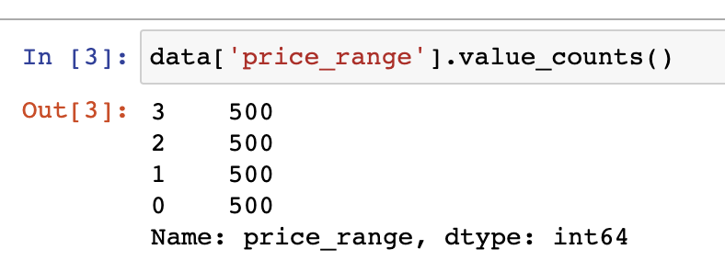
The story is that we would like to predict the price category for the specific products. First we depict the target variable:

Slide 3
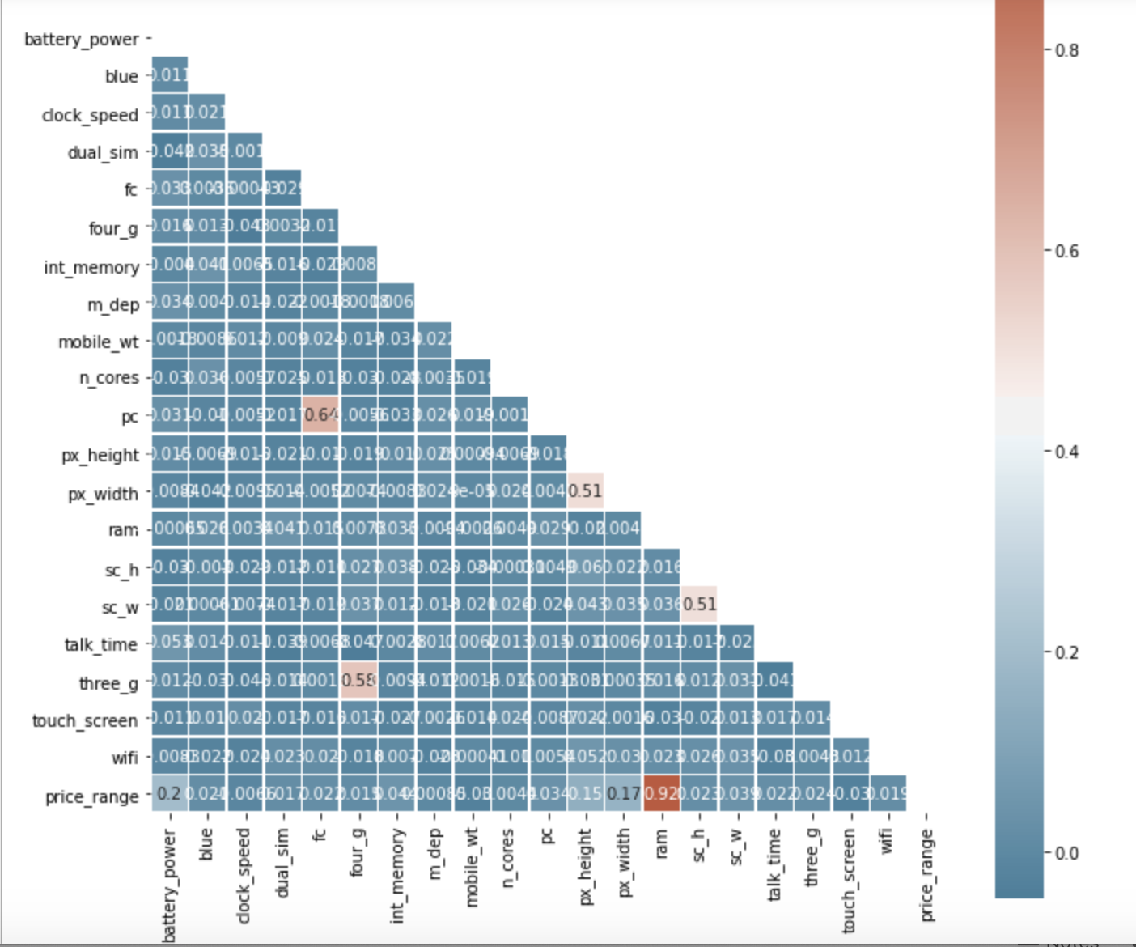
Correlation between the variables, the result is good and no highly coorelated variable was detected.

Slide 4
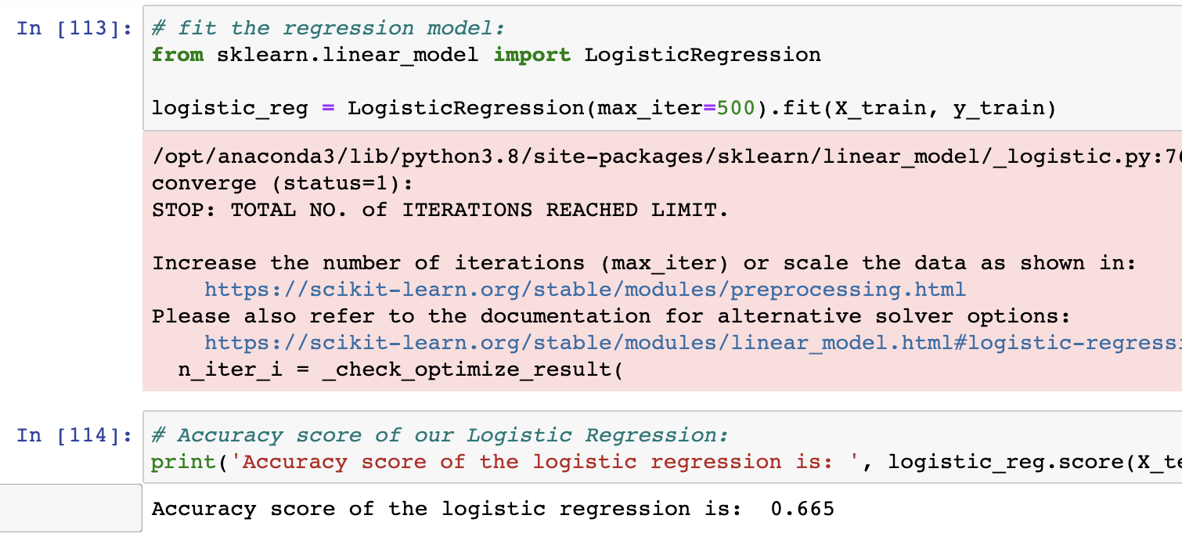
Application of Logistic regression

Slide 5
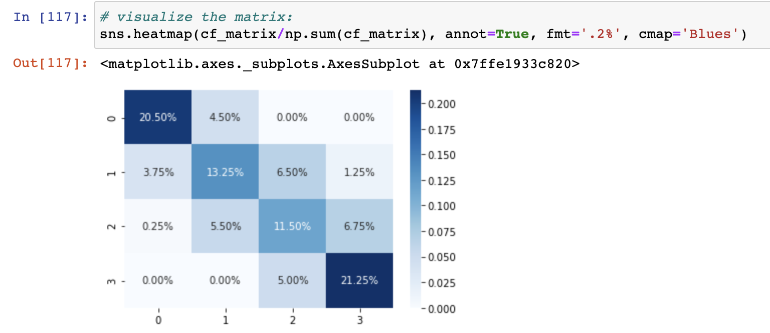
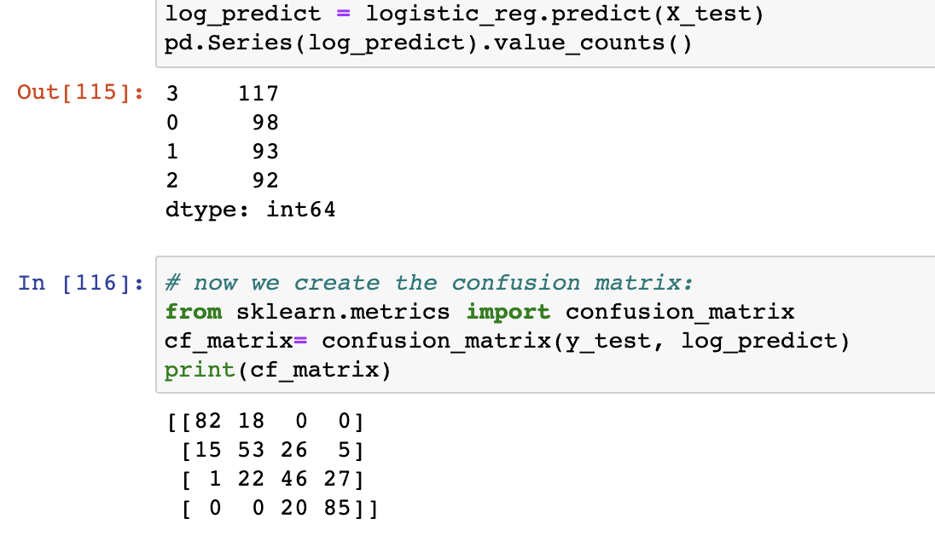
Logistic regression – confusion matrix

Slide 6
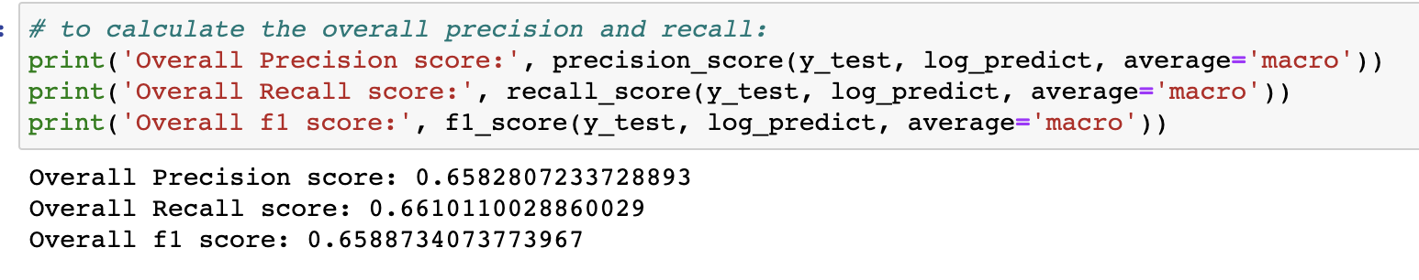
Over score for Logistic Regression

Slide 7
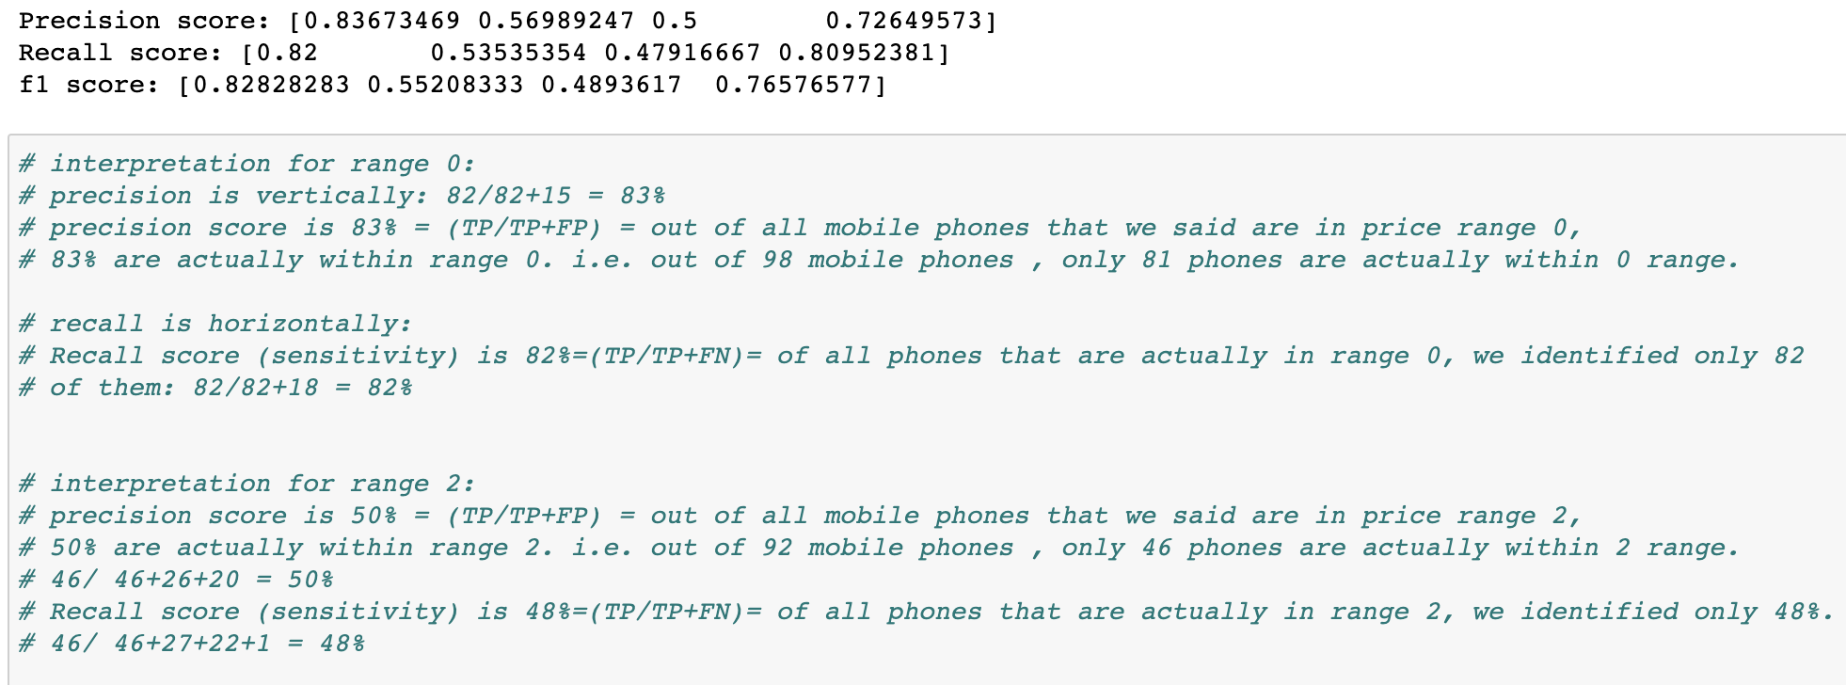
Detailed scores with some interpretation

Slide 8
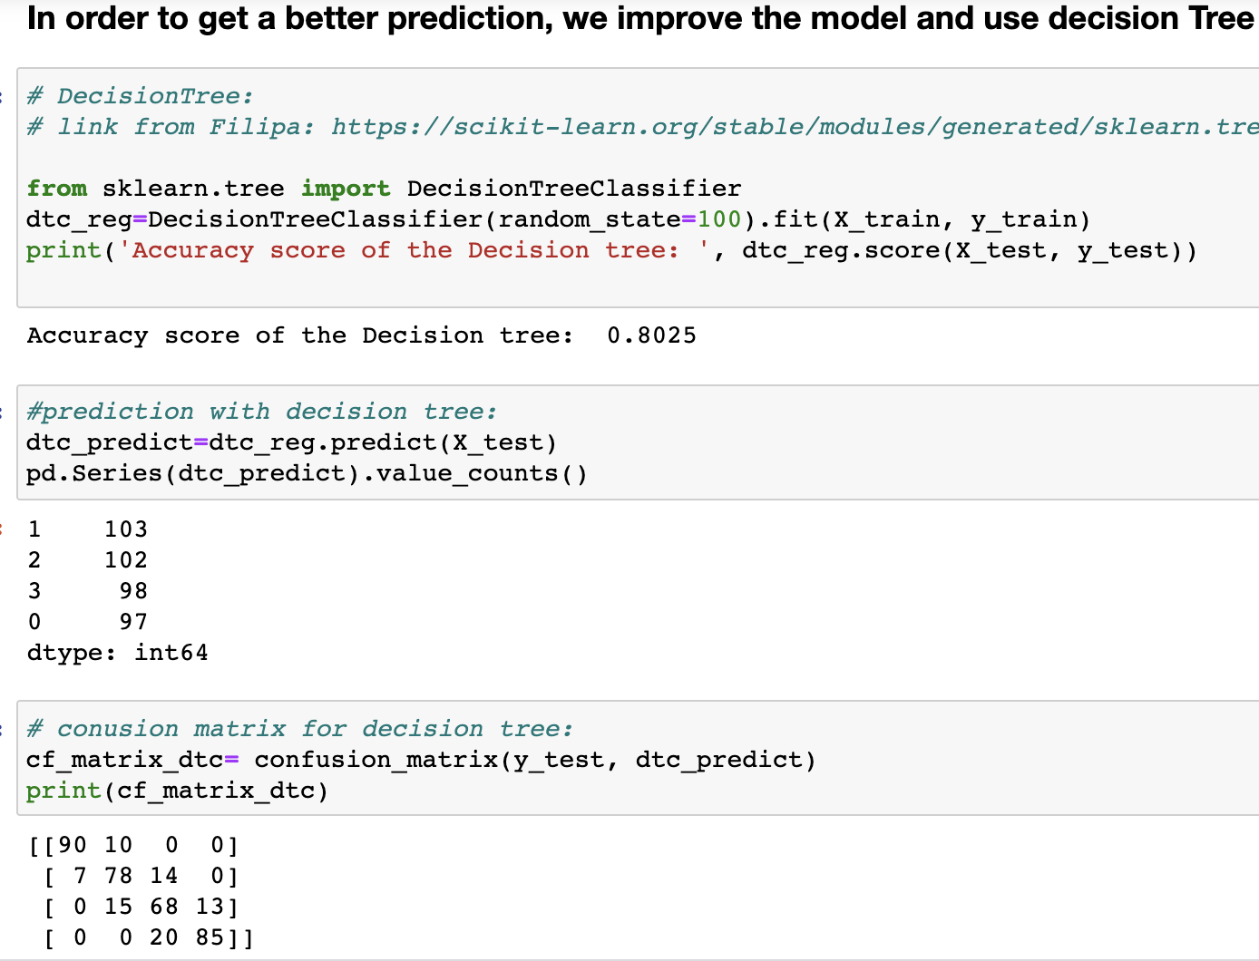
Employ DecisionTree to improve the prediction

Slide 9
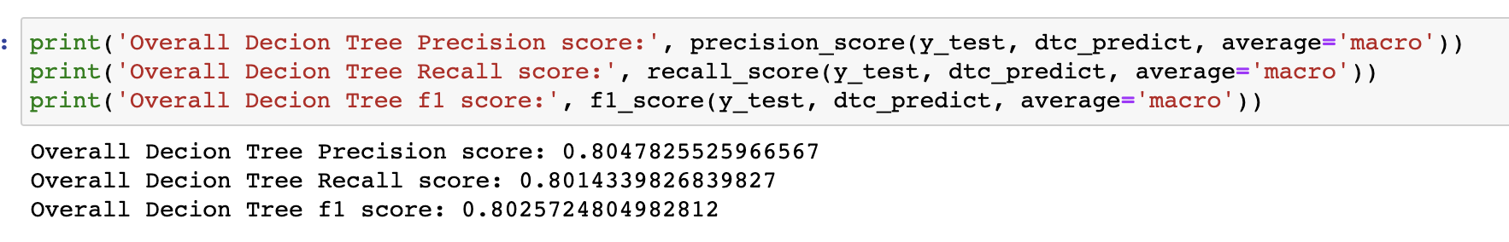
Overall score for DecisionTree regression

Slide 10
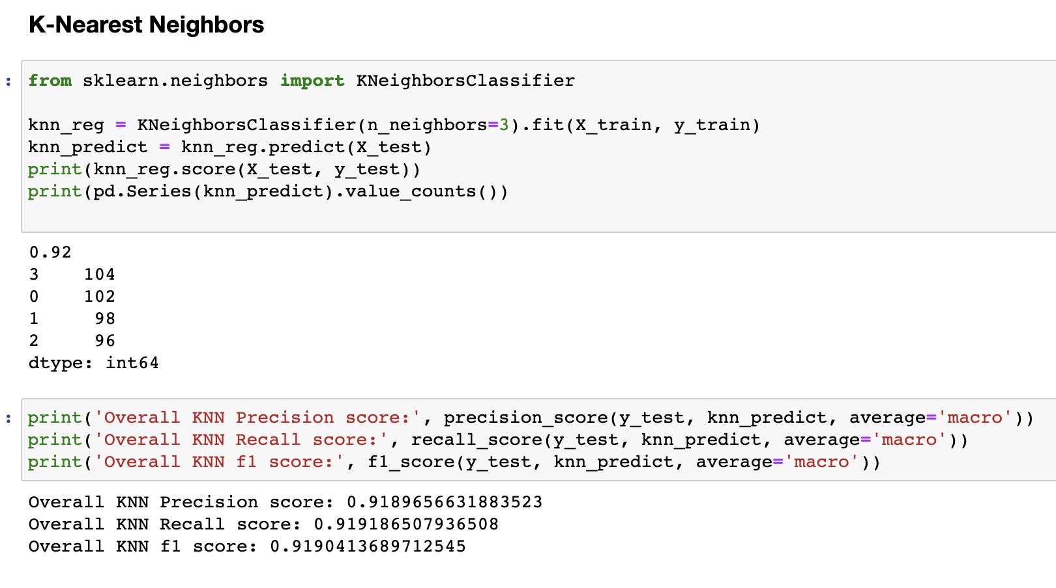
K-Nearest Neighbors regression and its scores

Slide 11
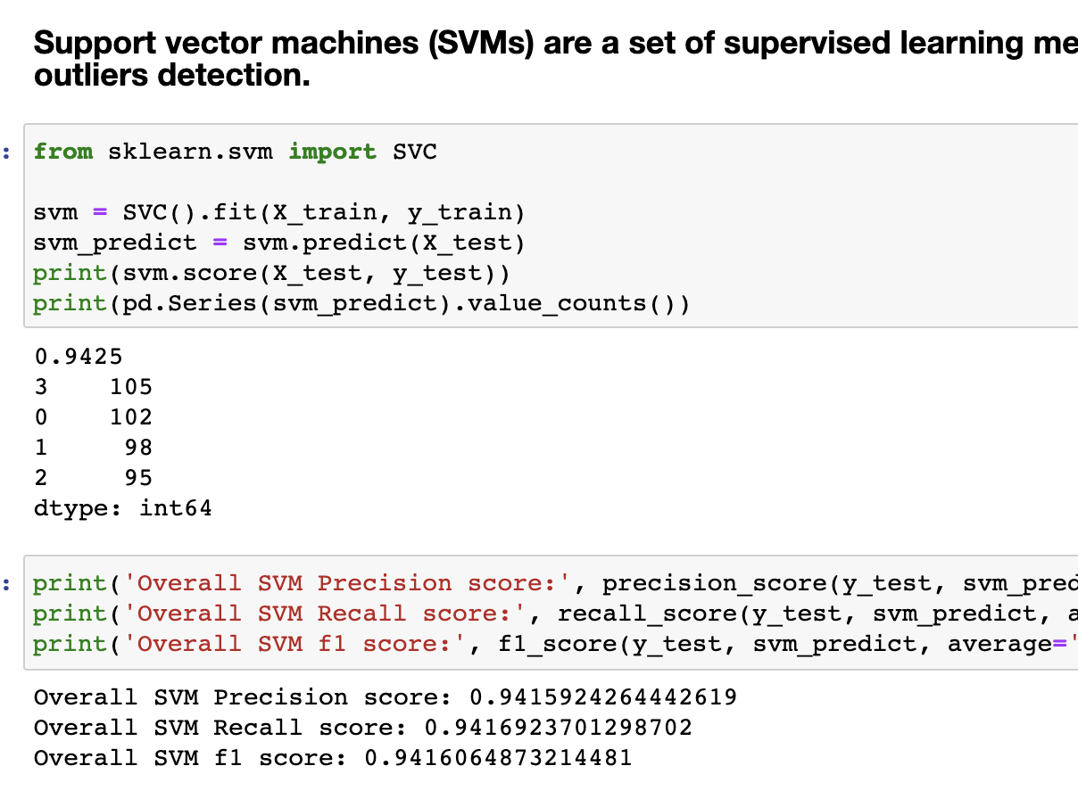
SVM and its scores

Slide 12
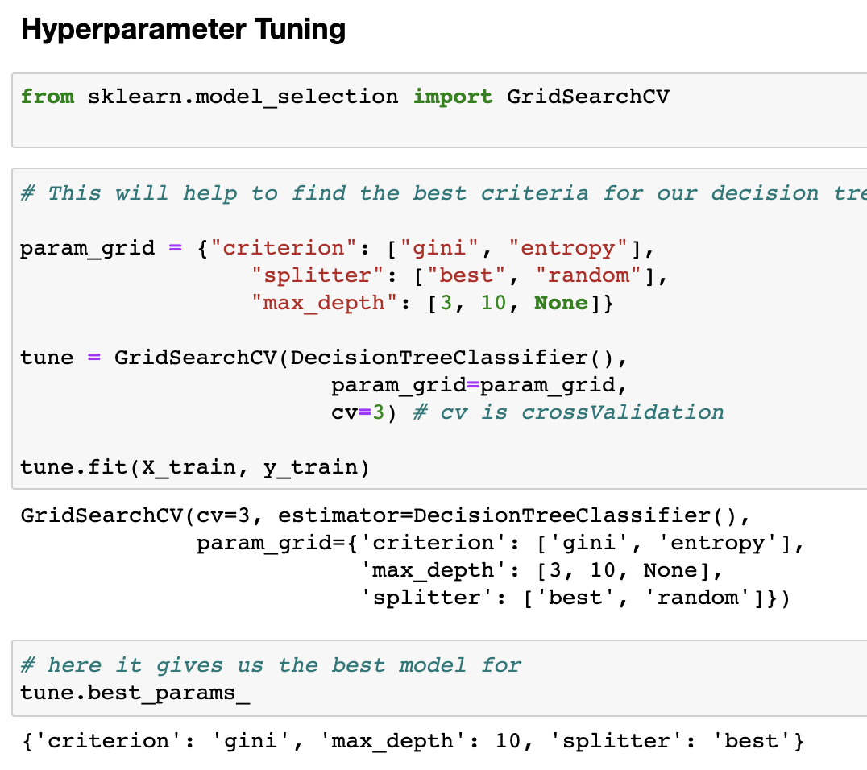
Hyprtparameter tuning

Slide 13
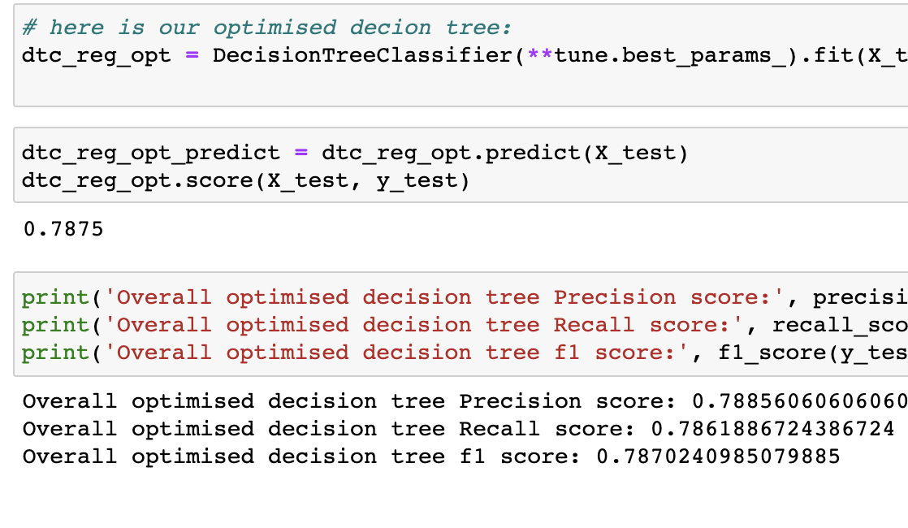
Hyprtparameter tuning on DeciusionTree, but surprisingly the performane decreased ☹

Slide 14
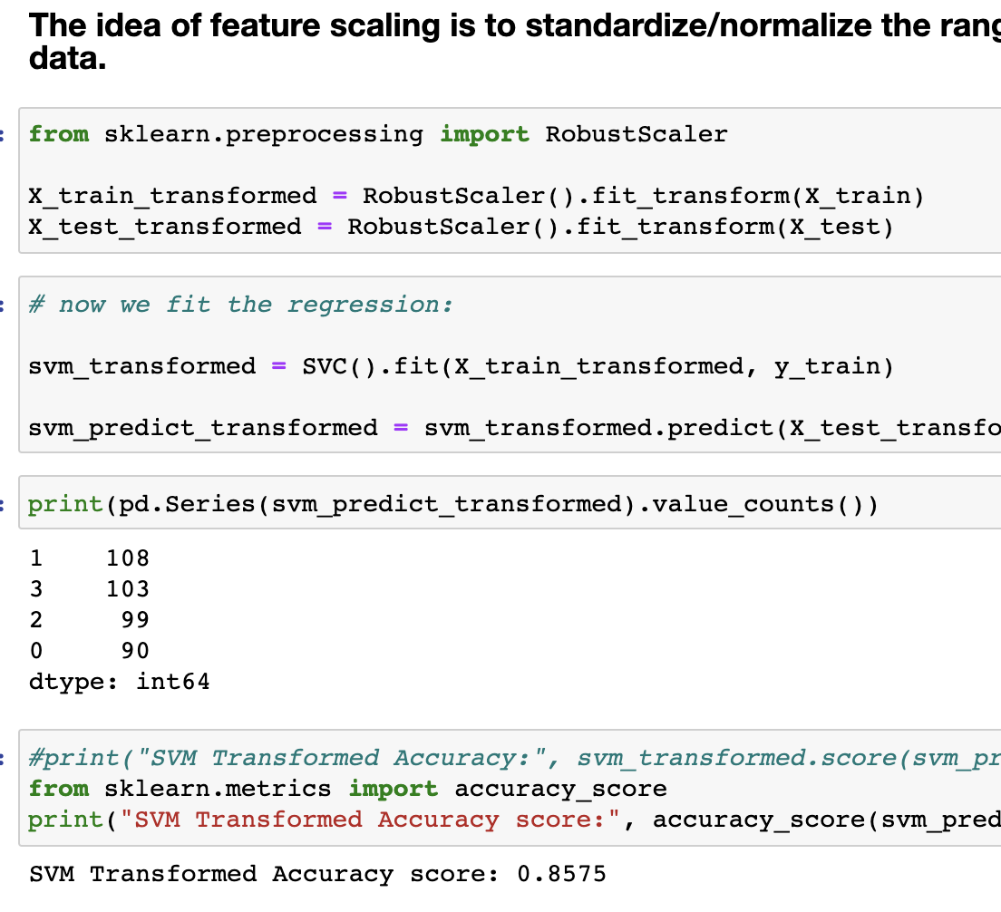
We performed the Feature Scaling, and reemploy the SVM to see if it improves the performance, but unfortunaly not :(

Slide 15
